Slide 1


DEPARTMENT OF COMPUTER SCIENCE AND ENGINEERING
20CS8504 & PROJECT WORK
END SEMESTER PRACTICAL EXAMINATION - APRIL/MAY - 2026
Batch No.: 7
Date: 30-03-2026
Session: FN

Slide 2
DIGITAL FORENSIC SCENE RECONSTRUCTION AND EVIDENCE MANAGEMENT USING IMAGE-BASED 3D RECONSTRUCTION AND COMPUTER VISION
Guide Name:
Mrs.S.Gayathri,M.E.,
Assistant Professor
Department of CSE
Team Members:
Saraswathy P L (811722104135)
Shanmuga Shree M (811722104142)
Sharly Pricilla A (811722104143)
Srimathi K (811722104154)

Slide 3
OBJECTIVE OF THE PROJECT
1. To capture and manage digital forensic evidence using image data
2. To reconstruct crime scenes in 3D using image-based computer vision techniques.
3. To enable 360-degree interactive visualization of reconstructed scenes.
4. To securely store and organize forensic evidence and 3D models.
5. To reduce cost and time compared to traditional forensic reconstruction methods.

Slide 4
INTRODUCTION
1. Digital forensic scene reconstruction plays a crucial role in modern crime investigation and legal analysis.
2. Accurate documentation of crime scenes is essential to preserve evidence integrity and support judicial proceedings.
3. Image-based 3D reconstruction uses computer vision techniques to digitally recreate crime scenes from captured images.
4. Interactive 360-degree visualization helps investigators analyze spatial relationships more accurately.
5. Integrating evidence management with 3D reconstruction improves forensic efficiency, accuracy, and accessibility.

Slide 5
LITERATURE SURVEY
TITLE OF PAPER | AUTHORS | PAPER GIST | TECHNOLOGY USED
3D Forensic Crime Scene Reconstruction Involving Immersive Technology: A Systematic Literature Review (IEEE 2022) | Mfundo A. Maneli, Omowunmi E. Isafiade, | 3D Crime Scene Reconstruction • Virtual Reality (VR) • Photogrammetry | Image-based 3D reconstruction, Photogrammetry,SfM,VR visualization,Point cloud processing.
Crime Scene Reconstruction Using 3D Convolutional Neural Networks IEEE,2024 | Ramy Riad Hussein, Aman Sharma, P. B. Edwin Prabhakar, E. Krishnaveni, K Monica Sowmya, M. Ravikiran | 3D-CNN • Crime Scene Reconstruction • Deep Learning for Forensics | 3D-CNN,Deep learning-based feature extraction,Multi-view image processing,Tensor-based spatial modeling
3DFIRES: Few Image 3D Reconstruction for Scenes with Hidden Surfaces IEEE,2024 | Linyi Jin, Nilesh Kulkarni, David F. Fouhey | • Few-Image 3D Reconstruction • Hidden Surface Modeling • Scene Reconstruction Algorithms | Stereo vision,Depth estimation algorithms,Feature matching, Sparse point cloud reconstruction, Multi-view geometry.
Stereo-Photogrammetry Method for 3-D Reconstruction IEEE,2019 | Phuong Ngoc Binh Do, Quoc Chi Nguyen | • Stereo Photogrammetry • 3D Reconstruction • Depth Estimation | Stereo-photogrammetry, Camera calibration techniques, Epipolar geometry, Feature detection and matching, 3D triangulation.
Recon3D: Single Image 3D Reconstruction Using Explicit Priors IEEE,2024 | Ruiyang Chen, Mohan Yin, Jiawei Shen, Wei Ma | • Single Image 3D Reconstruction • Explicit Priors • Scene Geometry Estimation | Single-image 3D reconstruction, Deep neural networks,Depth estimation, Geometry priors, Image-to-3D mapping.

Slide 6
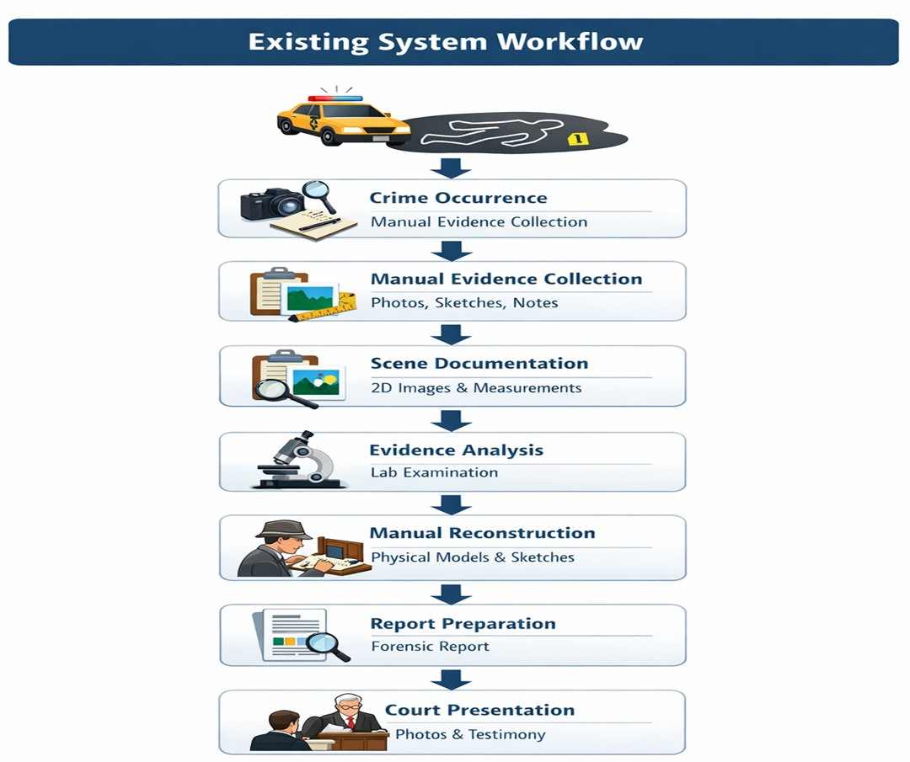
EXISTING SYSTEM

Slide 7
PROBLEM IDENTIFICAITON
Lack of Spatial Understanding
Incomplete Scene Documentation
Time Consuming Investigation Process
Difficulty in Evidence Visualization
Limited Collaboration
Lack of Interactive Analysis
Risk of Data Loss or Damage

Slide 8
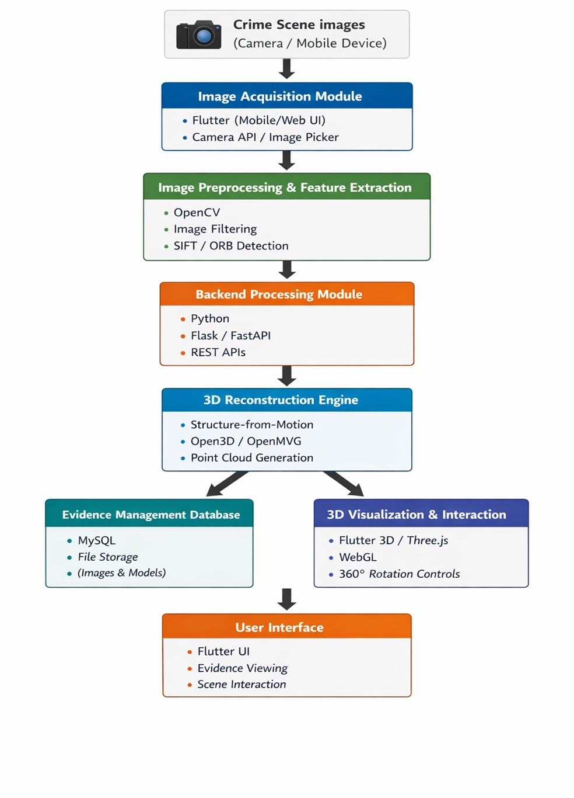
PROPOSED SYSTEM ARCHITECTURE

Slide 9
SOFTWARE AND HARDWARE REQUIREMENTS
HARDWARE
1. Processor: Intel i5 or higher
2. RAM: Minimum 8 GB
3. Storage: 256 GB SSD or higher
4. Camera: High-resolution digital camera / smartphone
5. Internet: Stable connection for data transfer
SOFTWARE
1. Internet: Stable connection for data transfer
2. Frontend: Flutter (Dart)
3. Backend: Python
4. Database: SQLite / MySQL
5. 3D Processing: OpenCV, OpenMVG, Open3D
6. Visualization: Three.js / Flutter 3D plugins
7. Tools: Visual Studio Code

Slide 10
MODULES
1. Image Acquisition Module
2. Evidence Management Module
3. Backend Processing Module
4. 3D Reconstruction Module
5. 3D Visualization and Interaction Module

Slide 11
IMPLEMENTATION OF MODULE-1
1. Captures crime scene images in real time using a camera or image selection interface.
2. Ensures images are collected from multiple angles for accurate scene reconstruction.
3. Validates image quality and format before further processing.
4. Associates captured images with a unique case or evidence ID.
5. Prepares and forwards image data securely to the backend processing module.

Slide 12
IMPLEMENTATION OF MODULE-2
1. Stores digital forensic evidence such as images and reconstructed 3D models securely.
2. Organizes evidence based on case ID, time, and evidence type.
3. Maintains evidence integrity to prevent unauthorized modification or loss.
4. Enables retrieval and review of evidence for forensic analysis and investigation.
5. Supports traceability of evidence throughout the forensic investigation process.

Slide 13
IMPLEMENTATION OF MODULE-3
1. Receives crime scene images uploaded from the image acquisition module.
2. Validates and stores image data on the server for further processing.
3. Prepares image datasets required for 3D reconstruction processing.
4. Coordinates communication between the mobile application and processing modules.
5. Sends processing status and results back to the application interface.

Slide 14
IMPLEMENTATION OF MODULE-4
1. Processes the collected crime scene images to extract visual features.
2. Applies image-based reconstruction techniques to estimate spatial structure.
3. Generates a three-dimensional representation of the crime scene.
4. Optimizes the reconstructed model for accurate spatial alignment.
5. Outputs the 3D model for visualization and further forensic analysis.

Slide 15
IMPLEMENTATION OF MODULE-5
1. Renders the reconstructed 3D crime scene model in an interactive viewer.
2. Allows users to rotate, zoom, and pan the scene for 360-degree inspection.
3. Enables real-time interaction with objects and evidence within the 3D space.
4. Supports smooth navigation to analyze spatial relationships and viewpoints.
5. Enhances forensic understanding through immersive visual exploration.

Slide 16
CONCLUSION
1. The system improves crime scene analysis by transforming real-time images into an interactive 3D visual environment
2. It enhances evidence accuracy, accessibility, and decision-making through advanced computer vision and 3D visualization.

Slide 17
FUTURE ENHANCEMENTS
Integration with Virtual Reality for immersive crime scene visualization
AI-based automatic evidence detection from images.
Real-time crime scene scanning using mobile devices or drones.
Cloud storage for secure data sharing and collaboration.
Advanced 3D simulation to recreate crime events.

